Slide 1

Stack
Presented by:
Elizer Ponio Jr.
Department of Computer Science
College of Computing and Information Technologies

Slide 2
Outline
What is a Stack?
Stack Operations
Implementations of a Stack
Applications of a Stack
Notes:
Have you asked yourself the question, why do people organize?
Lets go to the psychology of organizing
This predictability applies within the context of our homes, manifesting through the concept of organization

Slide 3
What is a Stack?
A stack is a linear data structure that follows the principle of Last In First Out (LIFO). This means the last element inserted inside the stack is removed first.
Notes:
Have you asked yourself the question, why do people organize?
Lets go to the psychology of organizing
This predictability applies within the context of our homes, manifesting through the concept of organization

Slide 4
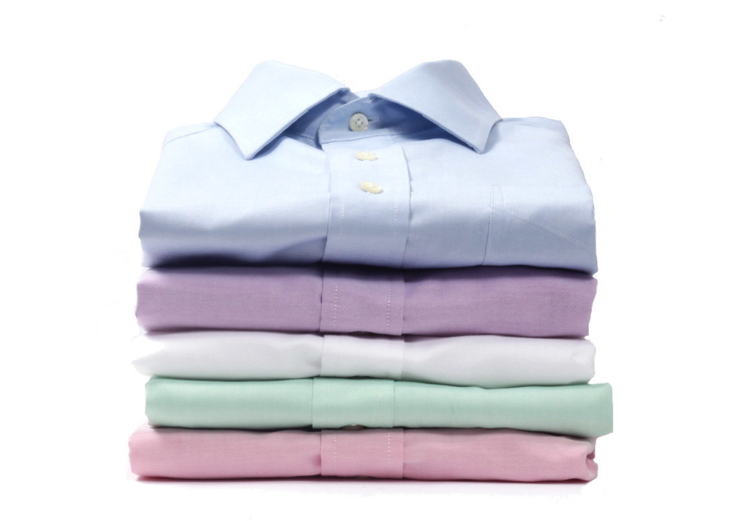
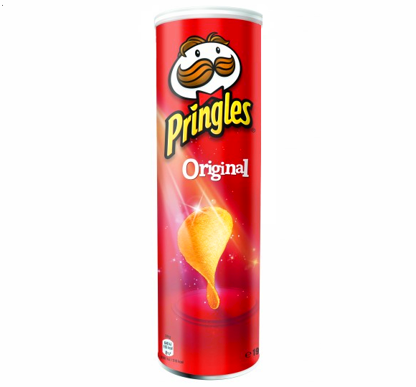
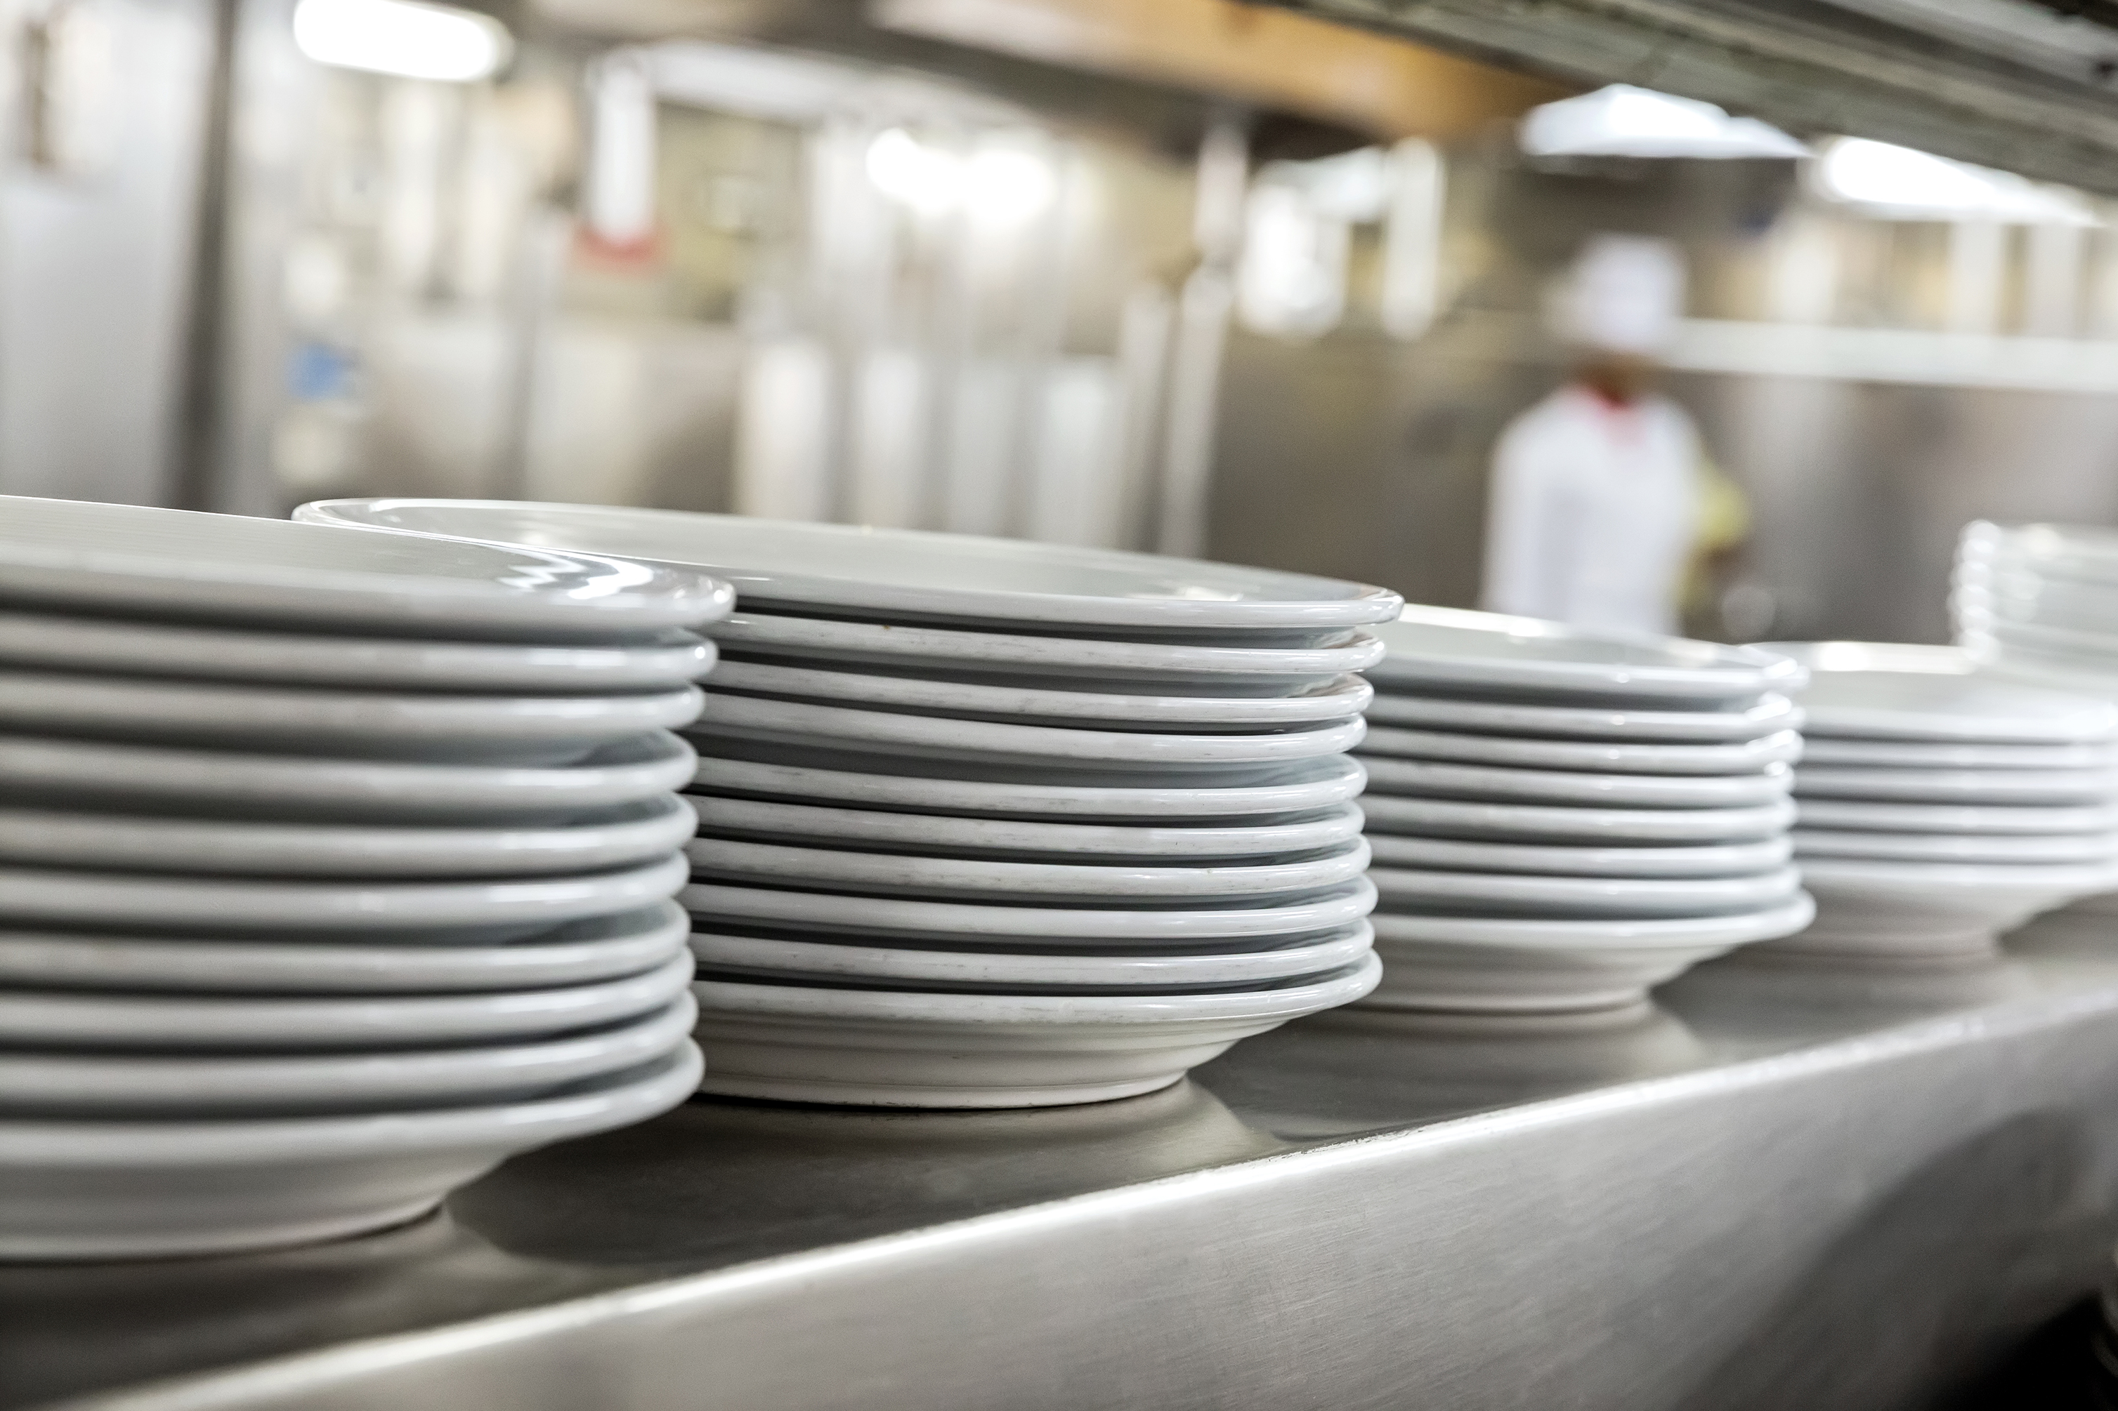
What is a Stack?
This Photo by Unknown Author is licensed under CC BY
Notes:
Have you asked yourself the question, why do people organize?
Lets go to the psychology of organizing
This predictability applies within the context of our homes, manifesting through the concept of organization

Slide 5
Last In First Out
Notes:
Have you asked yourself the question, why do people organize?
Lets go to the psychology of organizing
This predictability applies within the context of our homes, manifesting through the concept of organization

Slide 6

What is a Stack?
Stack Operations
Implementations of a Stack
Applications of a Stack
Notes:
Have you asked yourself the question, why do people organize?
Lets go to the psychology of organizing
This predictability applies within the context of our homes, manifesting through the concept of organization

Slide 7
Basic Operations in a Stack
Push
Pop
Size
Peek
Notes:
Have you asked yourself the question, why do people organize?
Lets go to the psychology of organizing
This predictability applies within the context of our homes, manifesting through the concept of organization

Slide 8
Push
Add an element to the top of a stack
Notes:
Have you asked yourself the question, why do people organize?
Lets go to the psychology of organizing
This predictability applies within the context of our homes, manifesting through the concept of organization

Slide 9
Pop
Remove an element to the top of a stack
Notes:
Have you asked yourself the question, why do people organize?
Lets go to the psychology of organizing
This predictability applies within the context of our homes, manifesting through the concept of organization

Slide 10
Size
Shows the total number of elements of the stack
Notes:
Have you asked yourself the question, why do people organize?
Lets go to the psychology of organizing
This predictability applies within the context of our homes, manifesting through the concept of organization

Slide 11
Peek
Shows the top element of the stack
Notes:
Have you asked yourself the question, why do people organize?
Lets go to the psychology of organizing
This predictability applies within the context of our homes, manifesting through the concept of organization

Slide 12
What is a Stack?
Stack Operations
Implementations of a Stack
Applications of a Stack
Notes:
Have you asked yourself the question, why do people organize?
Lets go to the psychology of organizing
This predictability applies within the context of our homes, manifesting through the concept of organization

Slide 13
Implementation of Stack
Because a stack is a linear data structure, it is possible to implement it or manually build it using a list or a linked list.
Notes:
Have you asked yourself the question, why do people organize?
Lets go to the psychology of organizing
This predictability applies within the context of our homes, manifesting through the concept of organization

Slide 14
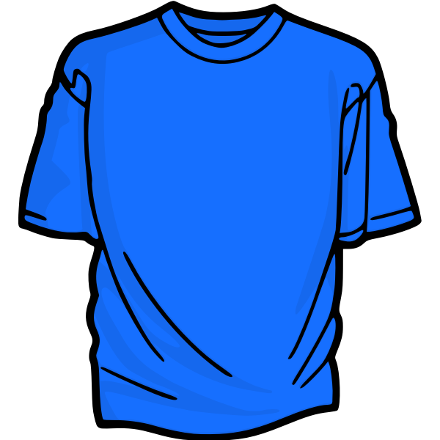
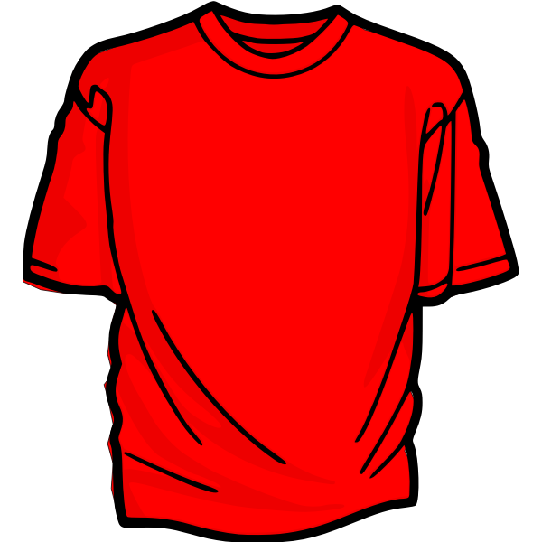
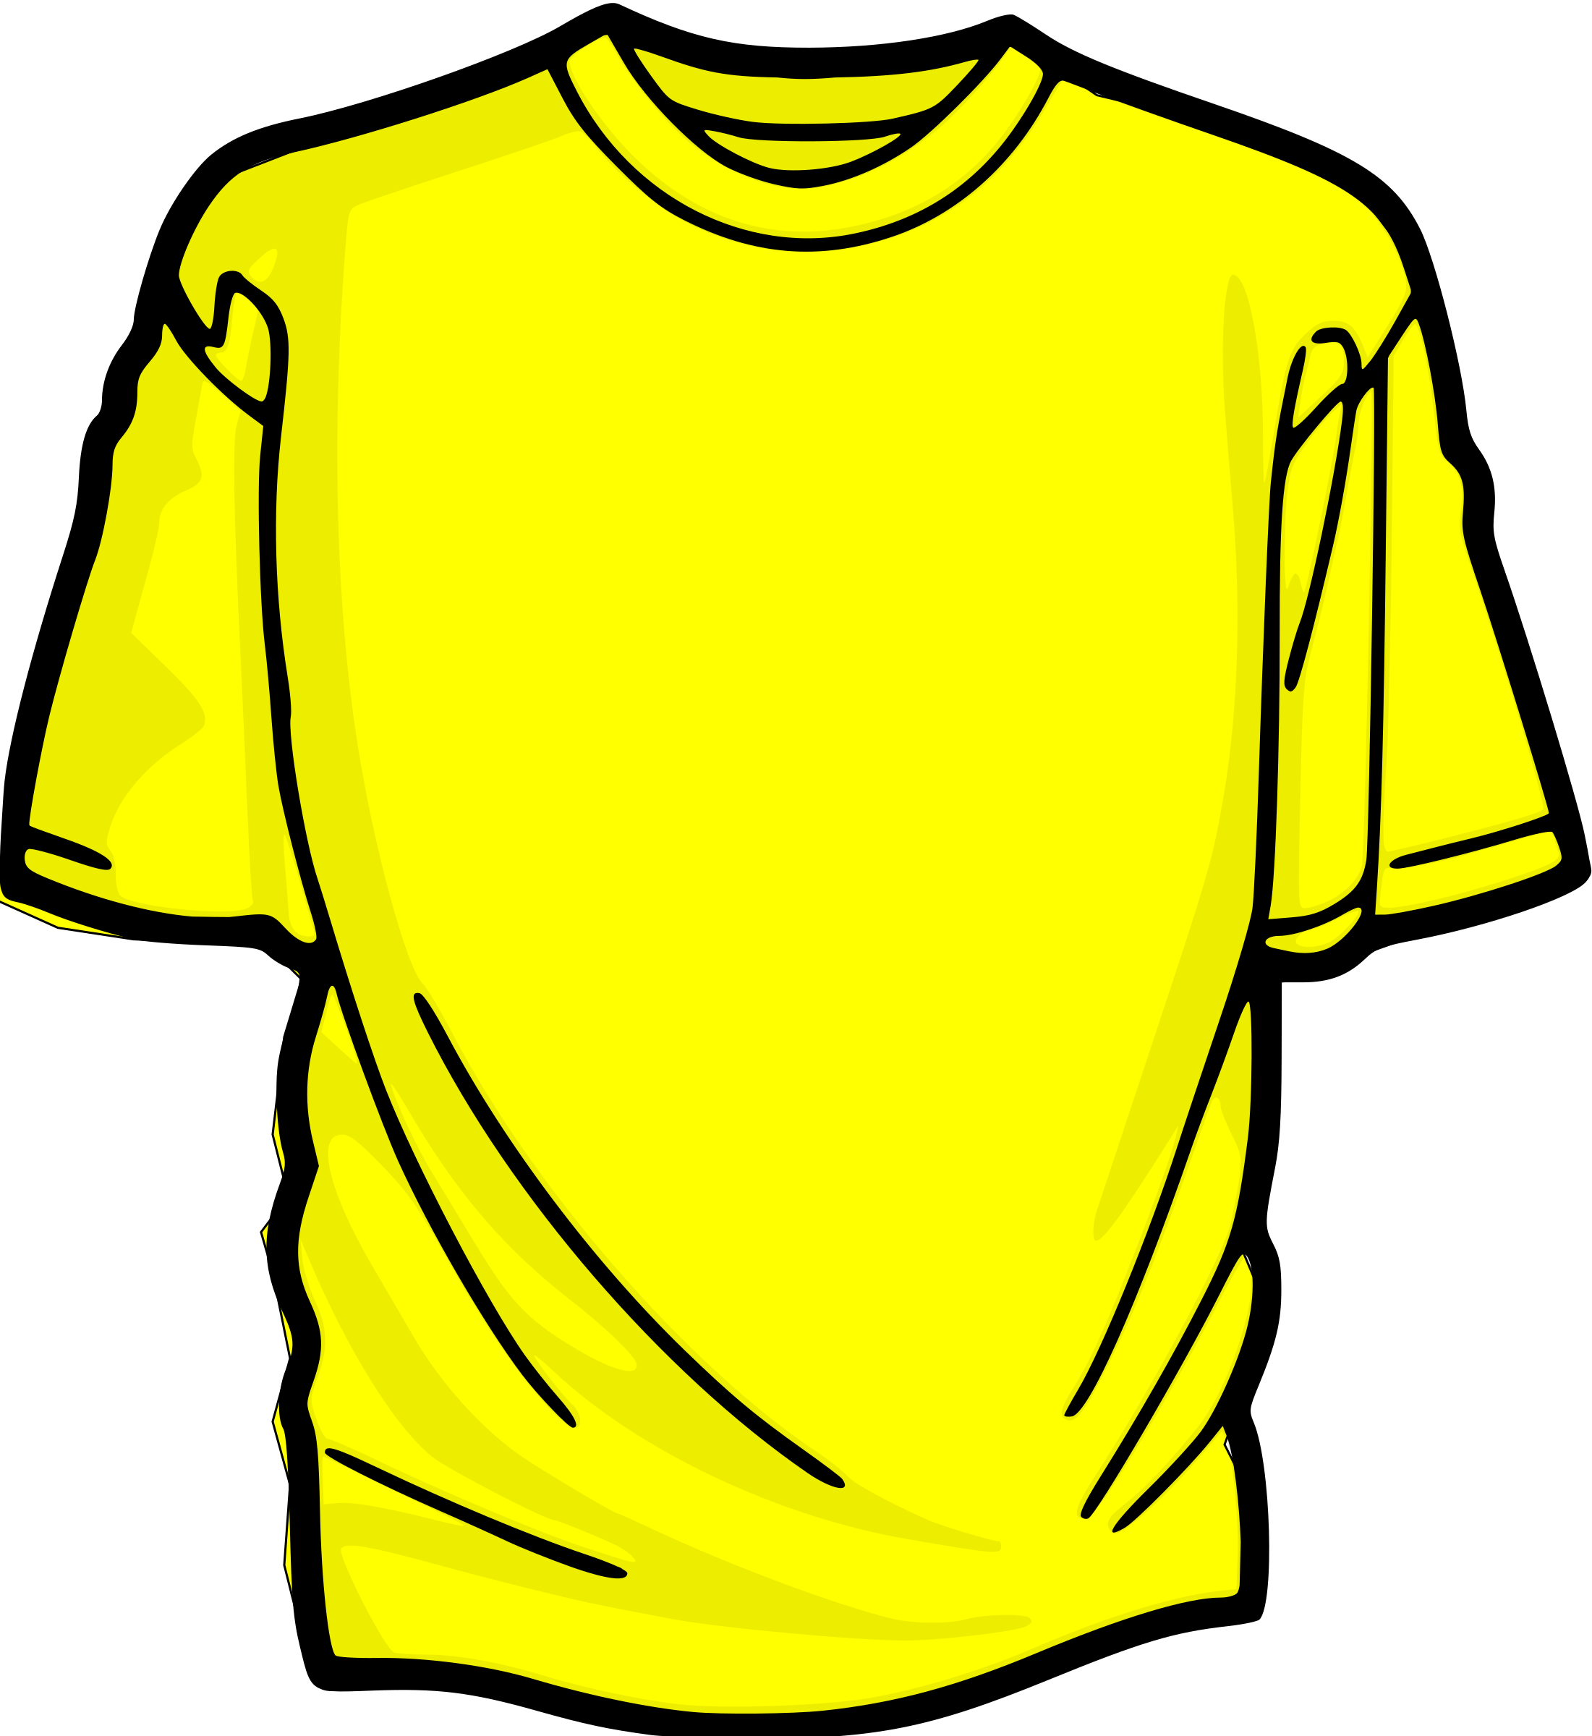
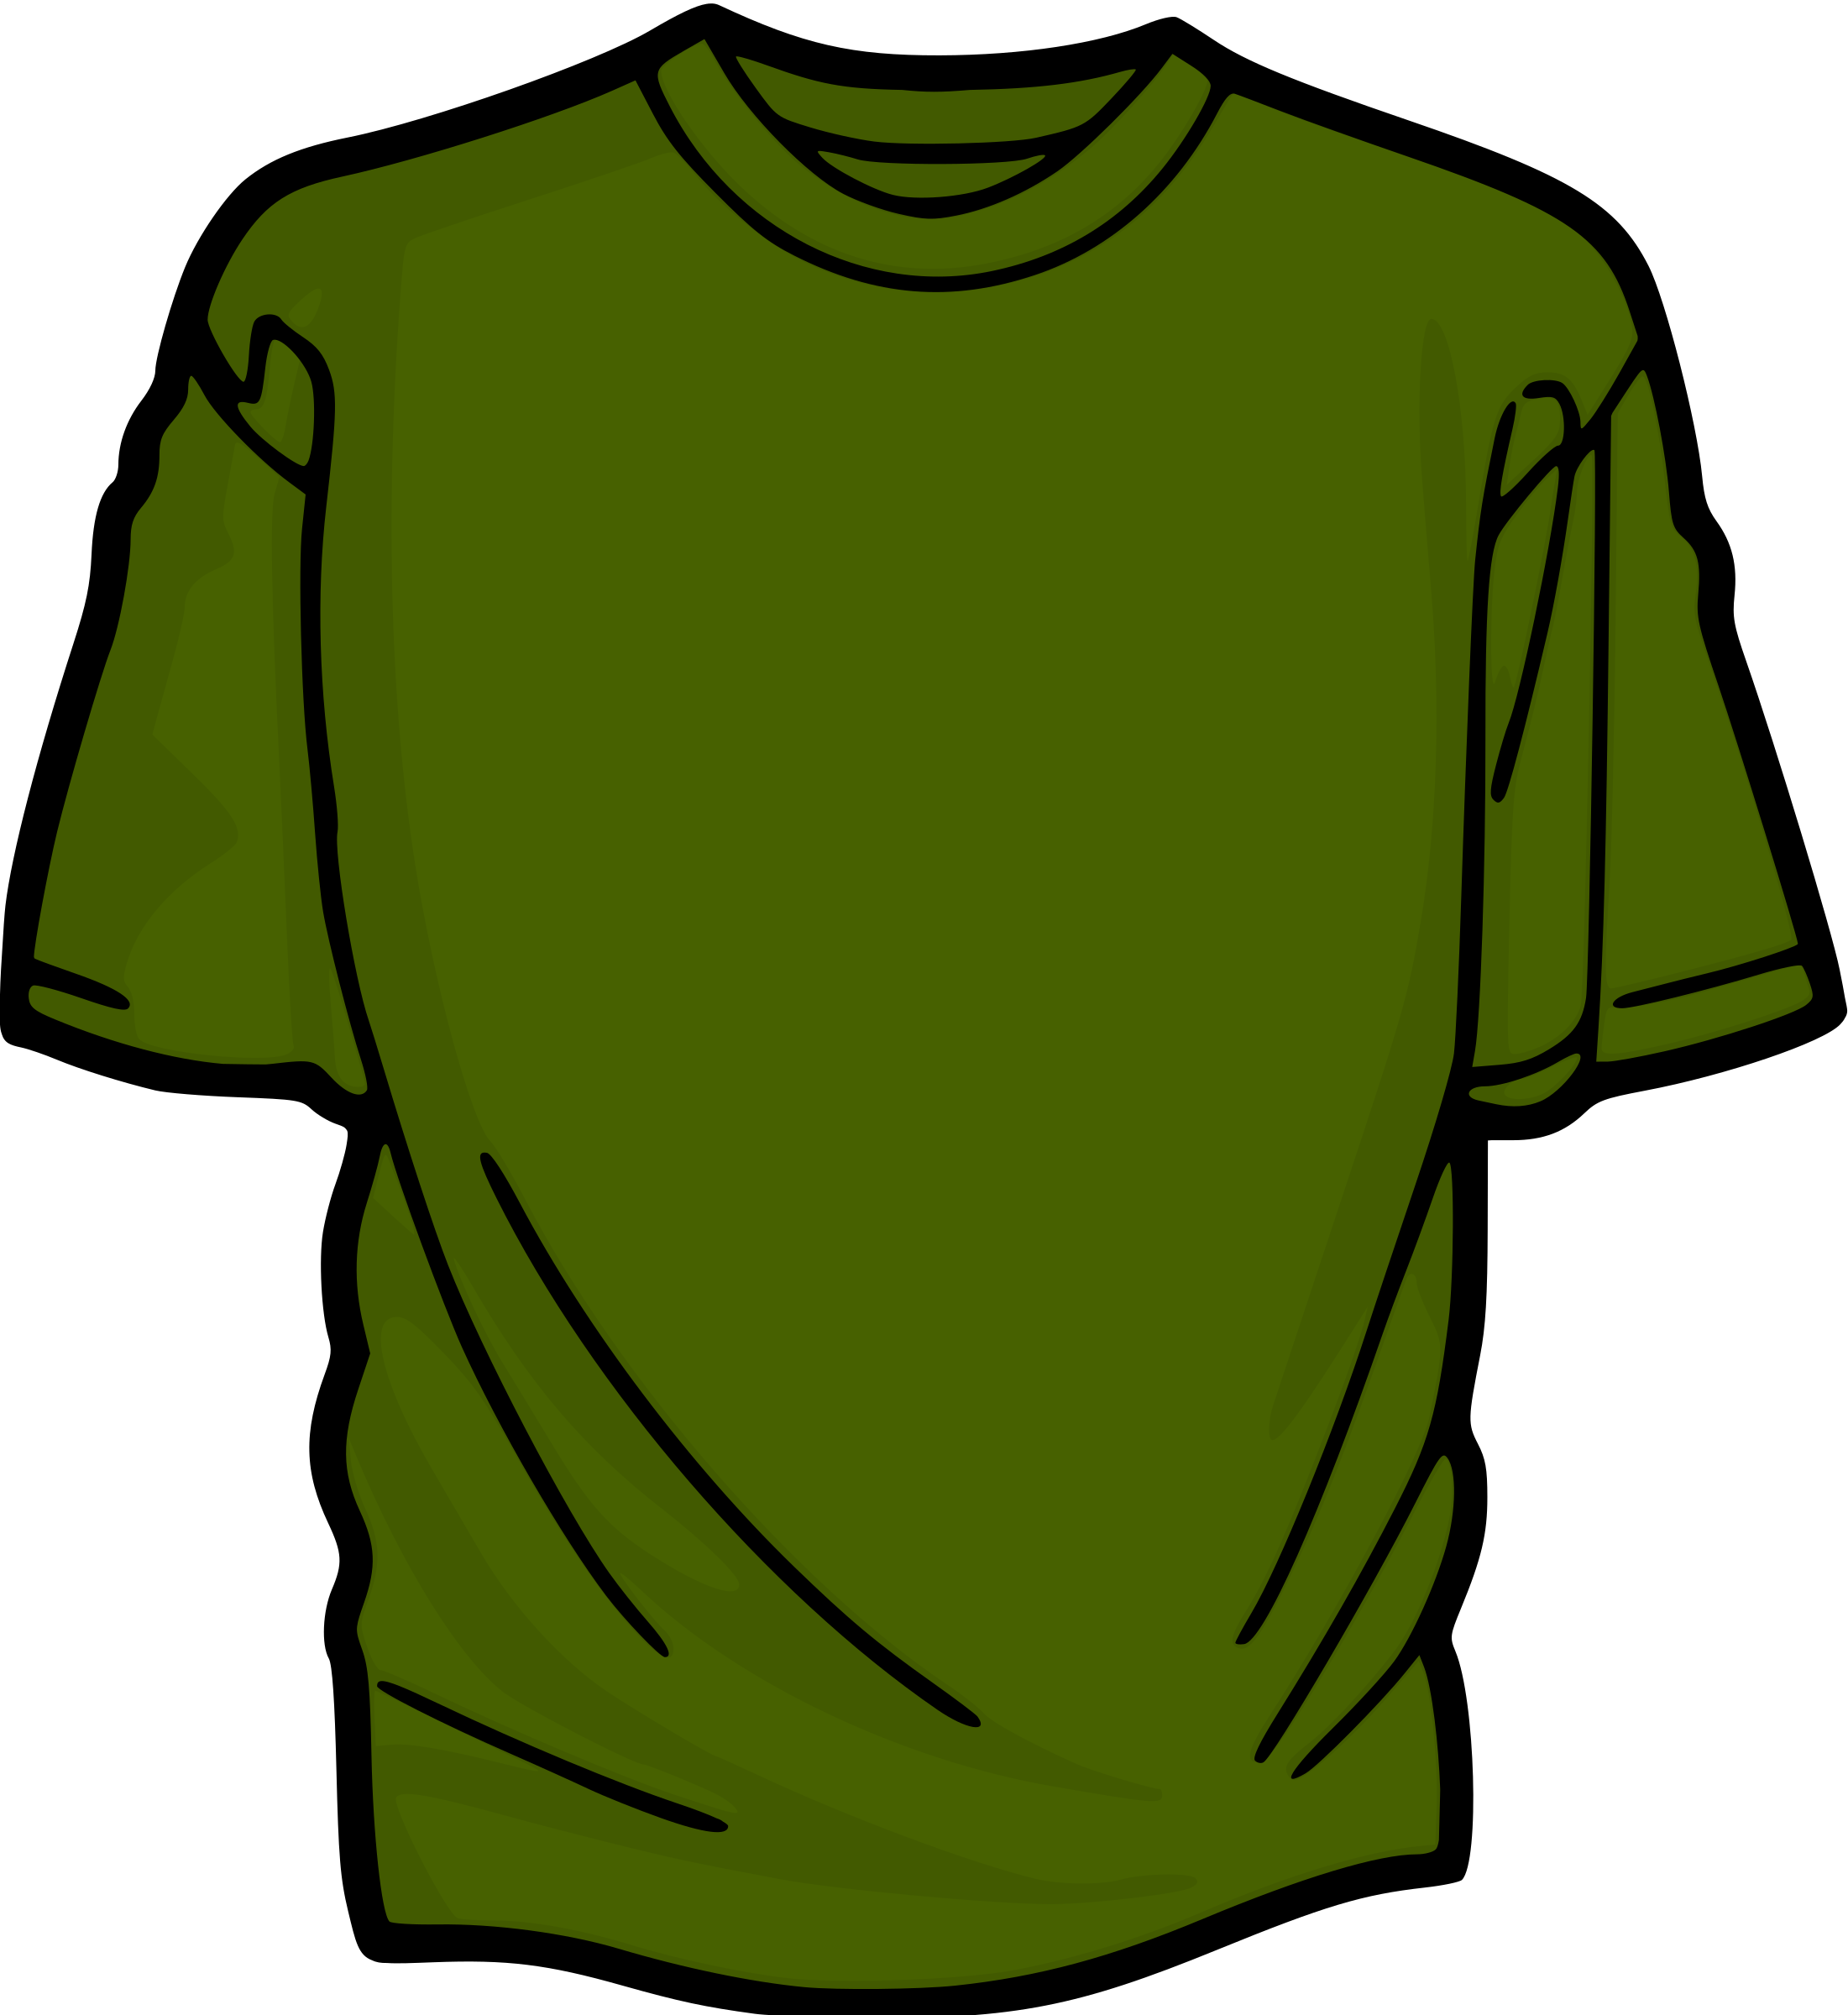
Stack implementation using Lists
Blue Shirt | Red Shirt | Yellow Shirt | Green Shirt
0 | 1 | 2 | 3 (TOP)
Green Shirt
Yellow Shirt
Red Shirt
Blue Shirt
Push Sequence:
Push (Blue Shirt)
Push (Red Shirt)
Push (Yellow Shirt)
Push (Green Shirt)
Notes:
Have you asked yourself the question, why do people organize?
Lets go to the psychology of organizing
This predictability applies within the context of our homes, manifesting through the concept of organization

Slide 15
Push operation
0 | 1 | 2 | 3
Blue Shirt
Red Shirt
Yellow Shirt
Green Shirt
(TOP)
Push Sequence:
Green Shirt
Stack.push(“Blue Shirt”)
Yellow Shirt
Stack.push(“Red Shirt”)
Stack.push(“Yellow Shirt”)
Red Shirt
Stack.push(“Green Shirt”)
Blue Shirt
Notes:
Have you asked yourself the question, why do people organize?
Lets go to the psychology of organizing
This predictability applies within the context of our homes, manifesting through the concept of organization

Slide 16
Pop operation
0 | 1 | 2 | 3
Blue Shirt
Red Shirt
Yellow Shirt
Green Shirt
Pop Sequence:
Green Shirt
Stack.pop()
Yellow Shirt
Stack.pop()
Stack.pop()
Red Shirt
Stack.pop()
Blue Shirt
Notes:
Have you asked yourself the question, why do people organize?
Lets go to the psychology of organizing
This predictability applies within the context of our homes, manifesting through the concept of organization

Slide 17
Stack Implementation using Linked Lists
Green Shirt
Yellow Shirt
Red Shirt
Blue Shirt
Top (Head)
Green Shirt
Yellow Shirt
Red Shirt
Blue Shirt
Push Sequence:
Stack.push(“Blue Shirt”)
Stack.push(“Red Shirt”)
Stack.push(“Yellow Shirt”)
Stack.push(“Green Shirt”)
Notes:
Have you asked yourself the question, why do people organize?
Lets go to the psychology of organizing
This predictability applies within the context of our homes, manifesting through the concept of organization

Slide 18
Push operation
Green Shirt
Yellow Shirt
Red Shirt
Blue Shirt
Head (Top)
Push Sequence:
Green Shirt
Stack.push(“Blue Shirt”)
Yellow Shirt
Stack.push(“Red Shirt”)
Stack.push(“Yellow Shirt”)
Red Shirt
Stack.push(“Green Shirt”)
Blue Shirt
Notes:
Have you asked yourself the question, why do people organize?
Lets go to the psychology of organizing
This predictability applies within the context of our homes, manifesting through the concept of organization

Slide 19
Pop operation
Green Shirt
Yellow Shirt
Red Shirt
Blue Shirt
Pop Sequence:
Green Shirt
Stack.pop()
Yellow Shirt
Stack.pop()
Stack.pop()
Red Shirt
Stack.pop()
Blue Shirt
Notes:
Have you asked yourself the question, why do people organize?
Lets go to the psychology of organizing
This predictability applies within the context of our homes, manifesting through the concept of organization

Slide 20
What is a Stack?
Stack Operations
Implementations of a Stack
Applications of a Stack
Notes:
Have you asked yourself the question, why do people organize?
Lets go to the psychology of organizing
This predictability applies within the context of our homes, manifesting through the concept of organization

Slide 21
Applications of a Stack
Reverse a word - Put all the letters in a stack and pop them out. Because of the LIFO order of stack, you will get the letters in reverse order.
In browsers - The back button in a browser saves all the URLs you have visited previously in a stack. Each time you visit a new page, it is added on top of the stack. When you press the back button, the current URL is removed from the stack, and the previous URL is accessed.
Notes:
Have you asked yourself the question, why do people organize?
Lets go to the psychology of organizing
This predictability applies within the context of our homes, manifesting through the concept of organization

